Slide 1
LEACH MAC PROTOCOL
Symbiosis Institute of Technology
m. tech - Embedded system
Presented by – Ankita Gupta (PRN-23070147001)

Slide 2
Introduction -
LEACH :
Proposed by Heinzelman.
Stands for Low Energy Adaptive Clustering Hierarchy.
It is a TDMA (Time divisible multiple access) based MAC Protocol.
It is designed specifically for Wireless sensor network.
It falls under rotating cluster based hierarchical networks.
It uses dynamic clustering method i.e work of cluster head changes after some time.
LEACH conserve energy through - Aggregation and Adaptive clustering.
In LEACH, base station is fixed and sensor nodes are homogenous.

Slide 3
HOW LEACH WORKS (overview) – Consists Two Phases
It is basically divided the system operation into fixed intervals called rounds.
A round basically a period from one instance of clustering phase to next cluster head selection.
Rounds in LEACH is determined as ratio of number of nodes(N) to expected number of clusters(K). Round = N/K
And each round is sub-divided into a setup phase and a steady state phase.
In Setup phase where cluster heads are selected.
And in Steady state phase where cluster head is maintained and data is transmitted between nodes.

Slide 4
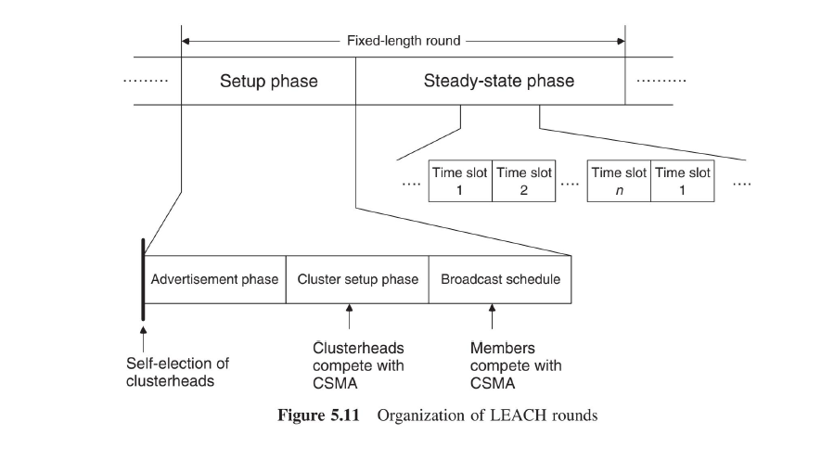
LEACH PROTOCOL OPERATION

Slide 5
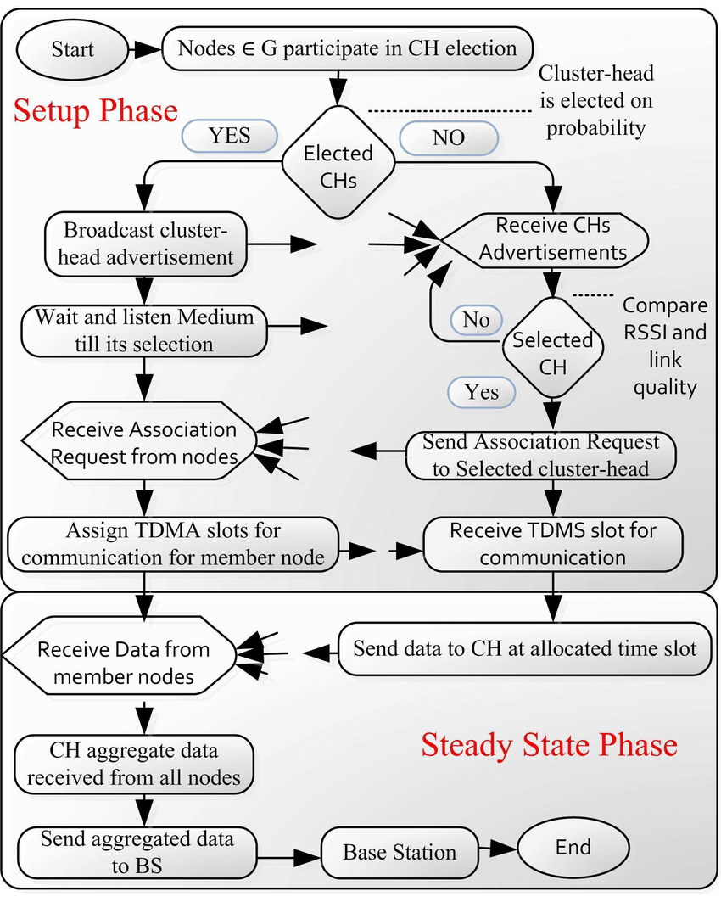
FLOW CHART OF LEACH ROUTING PROTOCOL

Slide 6
In each round of LEACH protocol following steps are performed :
Advertisement phase: The cluster head inform their neighbourhood with an advertisement packet.
Association phase: The sensor nodes receive the advertisement messages from cluster heads and select the cluster head to which they will associate.
Cluster formation: The cluster heads create clusters based on the sensor nodes that have associated with them.

Slide 7
Schedule creation: The cluster heads create a TDMA schedule for the sensor nodes in their cluster.
Data transmission: The sensor nodes transmit their data to the cluster heads according to the TDMA schedule.
Data aggregation: The cluster heads collect the data from the sensor nodes and transmit it to the base station.

Slide 8
Summary of LEACH WSN MAC PROTOCOL
Flat/ Clustered | Required Channels | Idle Listening Avoidance | Overhearing Avoidance | Collision Avoidance | Overhead
Rotating Clusters | 1 | By TDMA | By TDMA | By TDMA | Cluster election

Slide 9
WHY DO WE USE LEACH ?
Energy efficiency : employs a probabilistic cluster head selection mechanism and data aggregation to reduce energy consumption in the network.
Scalability : organizes nodes into clusters, allowing for more efficient data aggregation and transmission, which can handle a larger number of nodes.
Load balancing : load balancing technique helps prevent the rapid energy depletion of specific nodes, increasing the network's overall stability and lifetime.
Data aggregation : Data aggregation involves combining data from multiple sensor nodes into a single transmission to the base station.
Network lifetime extension : By optimizing energy usage, LEACH can significantly extend the operational lifetime of a WSN compared to non-energy-efficient routing protocols.

Slide 10
GOALS of LEACH :
It aims to conserve energy in WSNs.
It reduces energy consumption, which leads to an extended network lifetime.
It distributes energy consumption more evenly, which increases overall network stability.
It is feasible to deploy and maintain large scale WSNs.

Slide 11
LIMITATIONS of LEACH :
Uneven cluster head selections which lead to uneven distribution and clustering of cluster heads.
In scenarios where nodes are mobile, LEACH are not suitable, as it does not adopt to node mobility.
It does not address security concerns such as data confidentiality, integrity and authentication.
It does not provide support for quality of service requirement such as latency, reliability, or bandwidth guarantees.

Slide 12
Common application of LEACH include :
Environmental monitoring.
Precision agriculture.
Habitat monitoring.
Healthcare and medical monitoring.
Industrial automation.
Structural health monitoring.
Military and defence.
Disaster management.
Wildlife tracking.

Slide 13

THANK YOU!
ANY
QUERIES?

